Slide 1
Credit Analytics – Credit Default Modelling and predicting probability of defaults for unsecured loans

Slide 2

Credit Risk Modeling
Credit risk modeling – used by lenders to determine the level of credit risk associated with extending credit to a borrower
Credit risk modeling is a field with access to a large amount of diverse data where Machine Learning techniques can be deployed to add analytical value
With the continuous evolution of technology, banks are constantly researching and developing effective ways of modeling credit risk
Notes:
Image Link: https://www.vecteezy.com/vector-art/675254-hand-holding-phone-with-check-mark-for-project-finished-and-manager-sending-reward
Notes:
Credit risk is the chance of a borrower defaulting on a debt by failing to make the required payments. Risk is an inherent part of the lending paradigm for financial institutions and other lenders. Pinpointing the amount of risk that comes with each loan is a difficult task. Some of the factors that go into the complex credit risk calculation include the probability of default, the amount of exposure at the time of default, how much the loan is expected to be worth at the time of default, and the overall loss if there is a default.

Slide 3
Credit Risk Modeling
A growing number of financial institutions are investing in new technologies to make it possible to create credit risk models using machine learning languages, such as Python, R, etc.,
To predict the likelihood of default, lenders leverage historical data to guess how a consumer will behave in the future
Traditionally, credit risk models look for behavioral patterns in factors ranging from payment history to current level of indebtedness to average length of credit history

Slide 4

Credit Risk Modeling – Big Data and Analytics
The rise of analytics and Big Data have helped enhance the process of credit risk measurement. By leveraging data, there is less guesswork and more science behind the ability to predict whether someone will default on any given loan
With the recent prominence of innovative Big Data tools and analytics, it’s easier for consumers to capitalize on their credit opportunities and for financial institutions to reach and extend credit to consumers previously thought to be too risky
Notes:
Image Link: https://www.vecteezy.com/vector-art/2007284-concept-of-data-analysis-for-website-and-mobile-website-data-analytics-for-company-marketing-solutions-or-financial-performance-budget-accounting-or-statistics-concept-flat-design-illustration

Slide 5

How the Financial Industry is Digitizing Credit Risk Modeling
The financial industry is now using alternative financial data for credit analysis and modeling
This new approach looks not only at a consumer’s credit score, but at other real-world factors such as rent and utility payments
This hybrid report shows a clearer picture of a consumer’s transactional data, their assets/liabilities and non-income and deposit information, leading to better lending decisions
Notes:
Image Link: https://www.vecteezy.com/vector-art/2414708-crypto-currency-isometric-composition-vector-illustration
Notes:
The way consumers spend, save and borrow money is changing. Previous generations were taught to establish credit by making large purchases such as homes, furniture and cars, then make monthly payments on time. This determined a consumer’s creditworthiness, which could be boiled down into a FICO score.
Millennials have developed a different approach. Many rent homes rather than buy and ride bikes or share cars rather than buy vehicles. They often spend a large portion of their income on experiences rather than material items. This has resulted in a lack of established credit history for a cohort that tends to have a decent amount of income and financial responsibility.
The Consumer Financial Protection Bureau Office of Research reports that as many as 26 million Americans are “credit invisibles,” or people with limited credit histories and non-existent credit scores including millennials and others. On top of that, there are another 19 million “unscorables,” or people with insufficient credit history to generate a credit score.
Without a credit score, lenders have historically turned down requests for credit from these people and have declined to market loan offers to these groups. However, many of these consumers actually have banking and non-credit product history that can be used to create a better risk assessment. This alternate data can lead to greater access to credit markets for these consumers and an opportunity for lenders to offer financial products at reasonable risk as well as assess that ongoing risk during the life of the loan.
The financial industry is also now using alternative financial data for credit analysis and modeling. This new approach looks not only at a consumer’s credit score, but at other real-world factors such as rent and utility payments. This hybrid report shows a clearer picture of a consumer’s transactional data, their assets/liabilities and non-income and deposit information, leading to better lending decisions.

Slide 6
Factors affecting Credit Risk Modeling
Factors affecting credit risk modeling that lenders should consider:
Probability of Default (POD) - the likelihood that a borrower will default on their loan obligations
Loss Given Default (LGD) - refers to the amount of loss that a lender will suffer in case a borrower defaults on the loan
Exposure at Default (EAD) - evaluates the amount of loss exposure that a lender is exposed to at any particular time, and it is an indicator of the risk appetite of the lender
Notes:
Notes:
1. Probability of Default (POD)
The probability of default, sometimes abbreviated as POD, is the likelihood that a borrower will default on their loan obligations. For individual borrowers, POD is based on a combination of two factors, i.e., credit score and debt-to-income ratio.
The POD for corporate borrowers is obtained from credit rating agencies. If the lender determines that a potential borrower demonstrates a lower probability of default, the loan will come with a low interest rate and low or no down payment on the loan. The risk is partly managed by pledging collateral against the loan.
2. Loss Given Default (LGD)
Loss given default (LGD) refers to the amount of loss that a lender will suffer in case a borrower defaults on the loan. For example, assume that two borrowers, A and B, with the same debt-to-income ratio and an identical credit score. Borrower A takes a loan of $10,000 while B takes a loan of $200,000.
The two borrowers present with different credit profiles, and the lender stands to suffer a greater loss when Borrower B defaults since the latter owes a larger amount. Although there is no standard practice of calculating LGD, lenders consider an entire portfolio of loans to determine the total exposure to loss.
3. Exposure at Default (EAD)
Exposure at Default (EAD) evaluates the amount of loss exposure that a lender is exposed to at any particular time, and it is an indicator of the risk appetite of the lender. EAD is an important concept that references both individual and corporate borrowers. It is calculated by multiplying each loan obligation by a specific percentage that is adjusted based on the particulars of the loan.

Slide 7

Predicting the Probability of Default
Financial institutions use credit risk analysis models to determine the probability of default of a potential borrower
The models provide information on the level of a borrower’s credit risk at any particular time
If the lender fails to detect the credit risk in advance, it exposes them to the risk of default and loss of funds
Notes:
Image Link: https://www.vecteezy.com/vector-art/1783635-stock-market-crash-with-arrow-down

Slide 8

Predicting the Probability of Default
When a customer applies for a loan, banks and other credit providers use statistical models to determine whether to grant the loan based on the likelihood of the loan being repaid
The factors involved in determining this likelihood are complex, and extensive statistical analysis and modeling are required to predict the outcome for each individual case
Notes:
Image Link: https://www.vecteezy.com/vector-art/217016-trade

Slide 9

Predicting the Probability of Default
When the company receives a loan application, the company has to decide for loan approval based on the applicant’s profile
Two types of risks are associated with the bank’s decision: If the applicant is likely to repay the loan, then not approving the loan results is a loss of business to the company and if the applicant is not likely to repay the loan, i.e. he/she is likely to default, then approving the loan may lead to a financial loss for the company
Notes:
Image Link: https://www.vecteezy.com/vector-art/645317-hand-and-broken-piggy-bank

Slide 10
Python Case Study – Predicting Probability of Default
Objective:
Predict the likelihood of a customer defaulting on a loan
Dataset:
Peer-to-peer dataset from LendingClub - an American peer-to-peer lending company, it is the first peer-to-peer lender to register its offerings as securities with the Securities and Exchange Commission, and to offer loan trading on a secondary market.
We focus on the dataset which contains information from 2007-2018 Q4 on the customers with approved loans and with financial background and whether the loan has been repaid or not.

Slide 11
Python Case Study – Predicting Probability of Default
Data Preprocessing & EDA:
Exploratory analysis with respect to the target variable using pie charts, boxplots and countplots
Feature standardization – wherein different levels of similar nature in a categorical feature are grouped into one level
Missing value imputation – identify and fix missing values
Feature Scaling – scaling numerical features to reduce variance
Feature Engineering – creating features based on existing features that encapsulate all the necessary information
Create dummies – binary columns to indicate the presence and absence of a specific information, encoded as ‘1’ and ‘0’ respectively
Oversampling – increasing the samples of minority class from the existing ones to overcome class imbalance issues using SMOTE

Slide 12
SMOTE
Imbalanced classification involves developing predictive models on classification datasets that have a severe class imbalance
One approach to addressing imbalanced datasets is to oversample the minority class.
The simplest approach involves duplicating examples in the minority class, although these examples don’t add any new information to the model. Instead, new examples can be synthesized from the existing examples. This is a type of data augmentation for the minority class and is referred to as the Synthetic Minority Oversampling Technique, or SMOTE for short.
Notes:
Notes:
Imbalanced classification involves developing predictive models on classification datasets that have a severe class imbalance.
The challenge of working with imbalanced datasets is that most machine learning techniques will ignore, and in turn have poor performance on, the minority class, although typically it is performance on the minority class that is most important.
One way to solve this problem is to oversample the examples in the minority class. This can be achieved by simply duplicating examples from the minority class in the training dataset prior to fitting a model. This can balance the class distribution but does not provide any additional information to the model.
An improvement on duplicating examples from the minority class is to synthesize new examples from the minority class. This is a type of data augmentation for tabular data and can be very effective.
SMOTE works by selecting examples that are close in the feature space, drawing a line between the examples in the feature space and drawing a new sample at a point along that line.
Specifically, a random example from the minority class is first chosen. Then k of the nearest neighbors for that example are found (typically k=5). A randomly selected neighbor is chosen and a synthetic example is created at a randomly selected point between the two examples in feature space. The approach is effective because new synthetic examples from the minority class are created that are plausible, that is, are relatively close in feature space to existing examples from the minority class.

Slide 13
Python Case Study – Predicting Probability of Default
Machine Learning algorithms:
Split the data into training data (to fit the model) and test data (to validate the model)
Since we are predicting the default rate – the likelihood of a customer defaulting – this is a Classification problem, specifically a Binary Classification problem as it has two levels – a ‘YES’ and a ‘NO’
We fit the following models with the training data – Logistic Regression, Decision Tree Classifier, Random Forest Classifier, Gradient Boost and Adaptive Boost

Slide 14
Random Forest Classifier
Random forest is a supervised learning algorithm
The "forest" it builds, is an ensemble of decision trees, usually trained with the “bagging” method. The general idea of the bagging method is that a combination of learning models increases the overall result
Random forest adds additional randomness to the model, while growing the trees. Instead of searching for the most important feature while splitting a node, it searches for the best feature among a random subset of features
This results in a wide diversity that generally results in a better model
Random forest prevents Overfitting by creating random subsets of the features and building smaller trees using those subsets

Slide 15
AdaBoost Classifier
Boosting is an ensemble technique that attempts to create a strong classifier from a number of weak classifiers
This is done by building a model from the training data, then creating a second model that attempts to correct the errors from the first model.
Models are added until the training set is predicted perfectly or a maximum number of models are added
AdaBoost is best used to boost the performance of decision trees on binary classification problems
AdaBoost was designed in such a way that at every step the sample distribution was adapted to put more weight on misclassified samples and less weight on correctly classified samples. The final prediction is a weighted average of all the weak learners, where more weight is placed on stronger learners

Slide 16
GradientBoosting Classifier
Gradient boosting algorithm builds first weak learner and calculates the Loss Function. It then builds a second learner to predict the loss after the first step. The step continues for third learner and then for fourth learner and so on until a certain threshold is reached
Gradient boosting increases the accuracy by minimizing the Loss Function (error which is difference of actual and predicted value) and having this loss as target for the next iteration
The main difference therefore is that Gradient Boosting is a generic algorithm to find approximate solutions to the additive modeling problem, while AdaBoost can be seen as a special case with a particular loss function (Exponential loss function). Hence, gradient boosting is much more flexible

Slide 17
Python Case Study – Predicting Probability of Default
Evaluation of models:
Evaluate model performance with the help of Confusion matrix, the classification report (which displays Precision, Recall and F1-Score), ROC-Score
Perform Hyperparameter tuning to optimize model performance and observe the best parameters that drives model performance
Compare all models and finalize on the model with the best metrics

Slide 18
Python Case Study – Predicting Probability of Default
Evaluation of models:
Accuracy Score isn’t the be-all, end-all of model performance, especially when dealing with imbalanced datasets
Precision, Recall and F1-score are used to understand model performance and can be tuned (based on the needed context) to optimize model performance

Slide 19
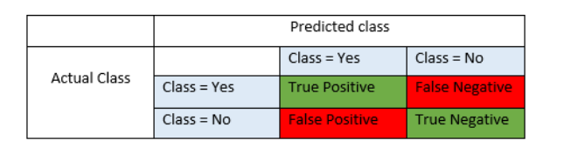
Confusion Matrix
A confusion matrix is a table that is often used to describe the performance of a classification model (or "classifier") on a set of test data for which the true values are known. The confusion matrix itself is relatively simple to understand, but the related terminology may be confusing.
Notes:
Image Link: https://blog.exsilio.com/all/accuracy-precision-recall-f1-score-interpretation-of-performance-measures/
Notes:
Confusion matrix is a contingency table that is often used to describe the performance of a classification model (or "classifier") on a set of test data whose true values are known, with two dimensions ("actual" and "predicted"), and identical sets of "classes" in both dimensions (each combination of dimension and class is a variable in the contingency table).

Slide 20
Confusion Matrix
True Positives (TP) - These are the correctly predicted positive values which means that the value of actual class is yes and the value of predicted class is also yes
True Negatives (TN) - These are the correctly predicted negative values which means that the value of actual class is no and value of predicted class is also no
False Positives (FP) – When actual class is no and predicted class is yes
False Negatives (FN) – When actual class is yes but predicted class in no
Notes:
Image Link: https://blog.exsilio.com/all/accuracy-precision-recall-f1-score-interpretation-of-performance-measures/
Notes:
True positive and true negatives are the observations that are correctly predicted and therefore shown in green.
False positives and false negatives occur when your actual class contradicts with the predicted class. Our goal is to minimize false positives and false negatives so they are highlighted in red.

Slide 21

Accuracy Score
Accuracy is the most intuitive performance measure and is simply a ratio of correctly predicted observations to the total observations
$$Accuracy= \frac{TP+TN}{TP+FP+FN+TN}$$
It is also used as a statistical measure of how well a binary classification test correctly identifies or excludes a condition.
Notes:
Notes:
Classification Accuracy is what we usually mean, when we use the term accuracy. It is the ratio of number of correct predictions to the total number of input samples.
Accuracy is a great measure but only when we have symmetric datasets where values of false positive and false negatives are almost same. Therefore, we have to look at other parameters to evaluate the performance of your model. As such, it compares estimates of pre- and post-test probability.

Slide 22

Precision & Recall
Precision is the ratio of correctly predicted positive observations to the total predicted positive observations
$$Precision= \frac{TP}{TP+FP}$$
Recall (sensitivity) is the ratio of correctly predicted positive observations to the all observations in actual class – yes
$$Recall= \frac{TP}{TP+FN}$$
Notes:
Notes:
Precision is calculated as the ratio between the number of Positive samples correctly classified to the total number of samples classified as Positive (either correctly or incorrectly). The precision measures the model's accuracy in classifying a sample as positive.
Precision is high when the model makes many correct Positive classifications (maximizes True Positive) or when the model makes fewer incorrect Positive classifications (minimizes False Positive). It reflects how reliable the model is in classifying samples as Positive.
Recall is calculated as the ratio between the number of Positive samples correctly classified as Positive to the total number of Positive samples. The recall measures the model's ability to detect Positive samples. The higher the recall, the more positive samples detected.
It cares only about how the positive samples are classified. This is independent of how the negative samples are classified such as in the case of precision. When the model classifies all the positive samples as Positive, then the recall will be 100% even if all the negative samples were incorrectly classified as Positive.

Slide 23
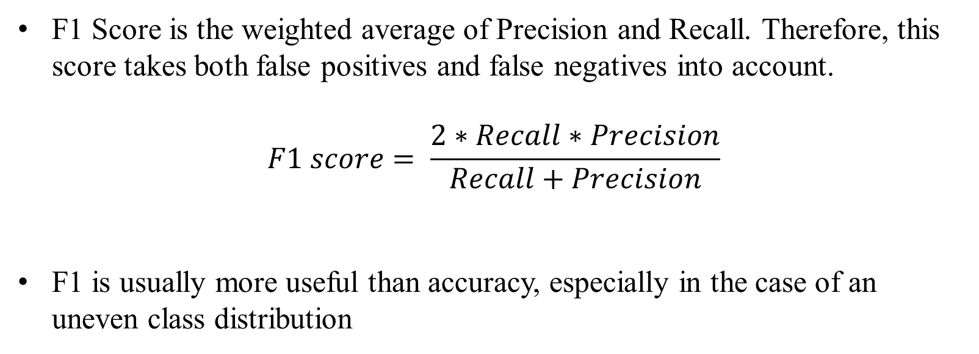
F1 – Score
F1 Score is the weighted average of Precision and Recall. Therefore, this score takes both false positives and false negatives into account.
$$F1 score= \frac{2∗Recall∗Precision}{Recall+Precision}$$
F1 is usually more useful than accuracy, especially in the case of an uneven class distribution
Notes:
Notes:
The decision of whether to use precision or recall depends on the type of problem being solved. If the goal is to detect all the positive samples (without caring whether negative samples would be misclassified as positive), then use recall. Use precision if the problem is sensitive to classifying a sample as Positive in general, i.e. including Negative samples that were falsely classified as Positive. Hence, we need a tradeoff between Precision and Recall.
There are also a lot of situations where both precision and recall are equally important. In such cases, we use F1-score. F1-score is the Harmonic mean of the Precision and Recall. F1 is usually more useful than accuracy, especially in the case of an uneven class distribution. Accuracy works best if false positives and false negatives have similar cost. If the cost of false positives and false negatives are very different, it’s better to look at both Precision and Recall.

Slide 24
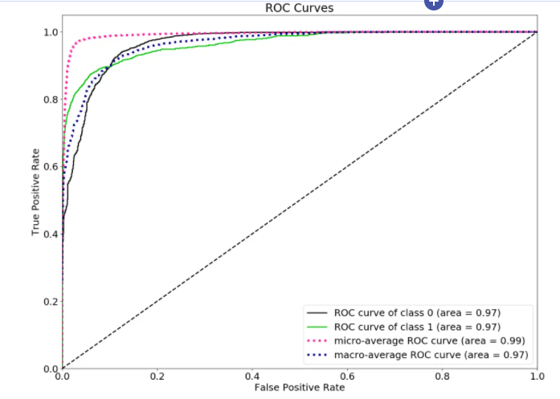
ROC-AUC
The Receiver Operator Characteristic (ROC) curve is a probability curve that plots the TPR against FPR at various threshold values and essentially separates the ‘signal’ from the ‘noise’.
The Area Under the Curve (AUC) is the measure of the ability of a classifier to distinguish between classes and is used as a summary of the ROC curve
Higher the TPR and lower the FPR for each threshold the better and so classifiers that have curves that are more top-left-side are better
The Area Under the ROC Curve, or ROC AUC score is equivalent to calculating the rank correlation between predictions and targets
Notes:
Image Link: https://neptune.ai/blog/f1-score-accuracy-roc-auc-pr-auc
Notes:
ROC is a probability curve and AUC represents the degree or measure of separability; tells how much the model is capable of distinguishing between classes.
We calculate the Area Under the ROC Curve, or ROC AUC score to interpret how good the curve is. ROC AUC score is equivalent to calculating the rank correlation between predictions and targets. From an interpretation standpoint, it is more useful because it tells us that this metric shows how good at ranking predictions your model is. It tells you what is the probability that a randomly chosen positive instance is ranked higher than a randomly chosen negative instance.

Slide 25
Python Case Study – Predicting Probability of Default
Post-modelling analysis and business takeaways:
Defaults can have consequences, such as lowering credit scores, reducing the chance of obtaining credit in the future, and raising interest rates on existing debt as well as any new obligations
The proportion of non-defaulters is almost 7 times more than defaulters, as observed from the dataset, which is a good sign for banks. But adequate measures to convert defaulters to non-defaulters must be undertaken

Slide 26
Python Case Study – Predicting Probability of Default
Post-modelling analysis and business takeaways:
Those with comparatively lower average fico score has mostly defaulted which is intuitive because low creditworthiness implies higher probability of default
Those who have mortgaged or rented homes default more in comparison with those who own homes, which isn't surprising since the obligation of mortgage or rent payment inadvertently affects their ability to repay loans
With regards to purpose of loan, 'debt' seems to stand high amongst defaulters. This implies those who availed loans to pay off other liabilities and consumer debts are more likely to default which is intuitive in itself.

Slide 27
Python Case Study – Predicting Probability of Default
Post-modelling analysis and business takeaways:
Banks and lending institutions must be cautious whilst extending loans and such for individuals with low credit score as they have a high chance of default
If the applicant appears to have rents or mortgages to be paid off, banks must ensure that would not hinder loan repayment in any manner or form
Those who have a history of debt or bankruptcy must be avoided at all costs as their probability of default would be high which in turn would turn out to be a huge loss for the bank

Slide 28
Python Case Study – LIME
LIME: Local Interpretable Model-Agnostic Explanations
LIME is an actual method developed by researchers to gain greater transparency on what’s happening inside an algorithm.
The researchers explain that LIME can explain “the predictions of any classifier in an interpretable and faithful manner, by learning an interpretable model locally around the prediction.”
What this means: LIME model develops an approximation of the model by testing it out to see what happens when certain aspects within the model are changed. Essentially it’s about trying to recreate the output from the same input through a process of experimentation

Slide 29

Python Case Study – How to run LIME
Install LIME in ANACONDA – pip install LIME
Import the following packages:
Extract all the features from your data and place them in different lists based on their type (float in one list, int64 in another)
Concatenate the list of features into a single list (utilized by the LIME explainer)
Run the Best model (lrclassifier_tuned) and obtain the prediction probabilities for the target variable (‘loan_status_encoded’) (needed for the LIME explainer)

Slide 30

Python Case Study – How to run LIME
Create the LIME explainer:
xtrain – training set
mode – type of model
training_labels – target variable
feature_names – concatenated list of features

Slide 31
Python Case Study – How to run LIME
Obtain the explanation from LIME for particular values in the test set:
The explainer takes a particular observation from the test set for which the probability values of each class is calculated. LIME will provide an explanation for assigning the probability
Check the LIME for observations that predict both 0 and 1, in this case index 0 (output ‘0’) and index 5 (output ‘1’), and compare the probability value to the actual class of the target variable for the prediction

Slide 32
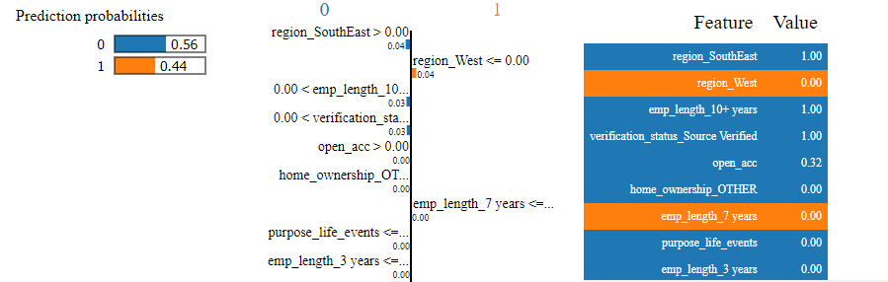
Python Case Study – How to Interpret LIME
Explanations for row 1 in test data that support class 0:
Prediction probabilities for class 0 and class 1 for xtest[0]
Features and their relative importances
The small numbers indicate importance score - "region_SouthEast" is assigned an importance of 0.04 - and the colour indicates if its contributing to 0 (blue) or 1 (orange).
The ranges (<=x=>) indicates if this feature’s value satisfies this criteria, it supports class 0 or 1
This particular loan applicant is expected not to default as he resides in the SouthEast region of USA and that he's been a long-time employee which does imply he/she may have enough resources to repay the money borrowed.
All features that support each class with their respective values

Slide 33
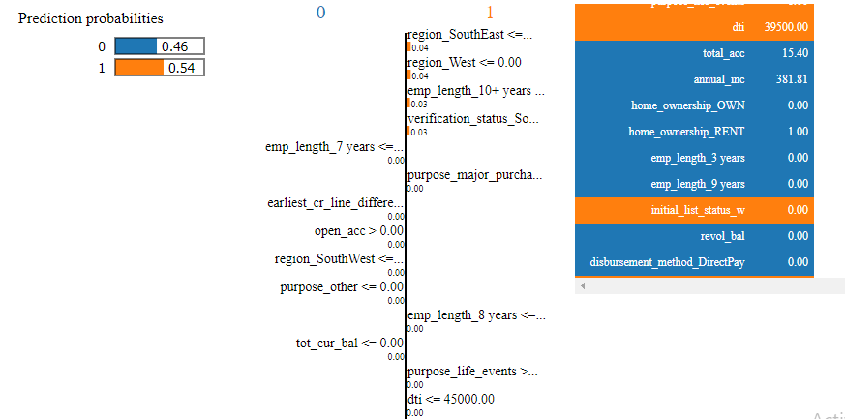
Python Case Study – How to Interpret LIME
Explanations for row 6 in test data that support class 1:
Prediction probabilities for class 0 and class 1 for xtest[5]
"dti" or debt-to-income ratio seems to be high which means the individual's income is not suficient enough to cover his/her debt, which in turn results in that person defaulting in loan payments.

Slide 34
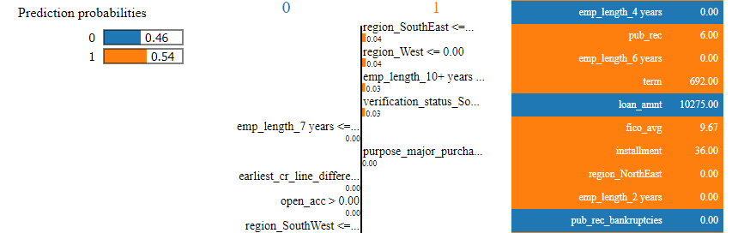
Python Case Study – How to Interpret LIME
Explanations for row 6 in test data that support class 1:
The number of derogatory public records denoted as "pub_rec" is also alarmingly high which reflects that there were unpaid financial obligations previously and therefore, this candidate carries a higher risk of default.
The average fico score is on the downside as well which isn't shocking considering the person's previous records and debt-to-income ratio.

Slide 35
Python Case Study – LIME
In business, a clear understanding of the model is not only necessary for ML experts but also to domain experts
As much as model accuracy drives businesses, it is equally important to have an inside view on what goes on. Understanding the what and why of every prediction builds trust in these ML models
LIME provides a global view of a model’s decision boundary and this model interpretability is essential when it comes to interactions between machines and humans

Slide 36
Hyperparameters (Important parameters)
LogisticRegression:
penalty: Used to specify the norm used in the penalization
solver: Algorithm to use in the optimization problem
C: Inverse of regularization strength; must be a positive float. Like in support vector machines, smaller values specify stronger regularization
https://scikit-learn.org/stable/modules/generated/sklearn.linear_model.LogisticRegression.html

Slide 37
Hyperparameters (Important parameters)
DecisionTreeClassifier:
criterion: The function to measure the quality of a split
max_depth: The maximum depth of the tree
splitter: The strategy used to choose the split at each node
max_features: The number of features to consider when looking for the best split
https://scikit-learn.org/stable/modules/generated/sklearn.tree.DecisionTreeClassifier.html

Slide 38
Hyperparameters (Important parameters)
RandomForestClassifier:
criterion: The function to measure the quality of a split
n_estimators: The number of trees in the forest.
max_depth: The maximum depth of the tree
min_samples_split: The minimum number of samples required to split an internal node
https://scikit-learn.org/stable/modules/generated/sklearn.ensemble.RandomForestClassifier.html

Slide 39
Hyperparameters (Important parameters)
AdaBoostClassifier:
base_estimator: The base estimator from which the boosted ensemble is built
n_estimators: The maximum number of estimators at which boosting is terminated
learning_rate: Weight applied to each classifier at each boosting iteration. A higher learning rate increases the contribution of each classifier
algorithm: calculation of class probabilities
random_state: Controls the random seed given at each boosting iteration
https://scikit-learn.org/stable/modules/generated/sklearn.ensemble.AdaBoostClassifier.html

Slide 40
Hyperparameters (Important parameters)
GradientBoostingClassifier:
learning_rate: Learning rate shrinks the contribution of each tree
n_estimators: The number of boosting stages to perform
loss: The loss function to be optimized
https://scikit-learn.org/stable/modules/generated/sklearn.ensemble.GradientBoostingClassifier.html

Slide 41
Thank You!

